Slide 1
Cyber Security Terminology

Slide 2
Index
Introduction
Cyber-security
Types of Cyber security
Types of cyber-security threats
Cyber safety tips -protect yourself against cyber-attacks

Slide 3
Introduction
Cyber-security is the practice of protecting computers, servers, mobile devices, electronic systems, networks, and data from malicious attacks/digital attacks.
These cyber attacks are usually aimed at accessing, changing, or destroying sensitive information; extorting money from users; or interrupting normal business processes.

Slide 4
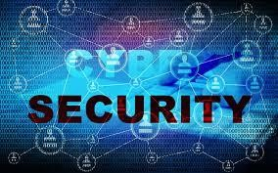
Cont…
Implementing effective cyber-security measures is particularly challenging today because there are more devices than people, and attackers are becoming more innovative.

Slide 5
Cyber-security
Cyber-security approach has multiple layers of protection spread across the computers, networks, programs, or data that one intends to keep safe.
In an organization, the people, processes, and technology must all complement one another to create an effective defences from cyber attacks.

Slide 6
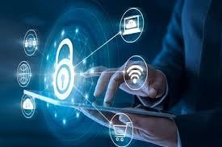
Cont…
It's also known as information technology security or electronic information security.

Slide 7
Cont…
Technology is essential to giving organizations and individuals the computer security tools needed to protect themselves from cyber attacks
Three main entities must be protected: Endpoint devices like Computers, Smart devices, and routers; Networks; and the cloud.
Common technology used to protect these entities include next-generation firewalls, DNS filtering, malware protection antivirus solutions software, and email security

Slide 8
Types of Cyber security
Network security:
It is the practice of securing a computer network from intruders, whether targeted attackers or opportunistic malware.
Application security:
It focuses on keeping software and devices free of threats.
A compromised application could provide access to the data its designed to protect.

Slide 9
Cont…
Information security:
It protects the integrity and privacy of data, both in storage and in transit.
Operational security:
It includes the processes and decisions for handling and protecting data assets.
The permissions users have when accessing a network and the procedures that determine how and where data may be stored or shared all fall under this umbrella.

Slide 10
Cont…
Disaster recovery and business continuity:
It define how an organization responds to a cyber-security incident or any other event that causes the loss of operations or data.
End-user education:
Addresses the most unpredictable cyber- security factor.
Recommended to delete suspicious email attachments, not plug in unidentified USB drives, and various

Slide 11
Importance of cyber-security
At an individual level, a cyber-security attack can result in everything from identity theft, to extortion attempts, to the loss of important data like family phots.
Every one relies on critical infrastructure like power plants, hospitals, and financial service companies

Slide 12
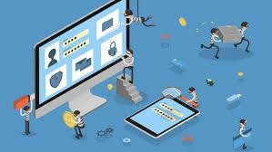
Types of cyber-security threats
The threats countered by cyber-security are three-fold:
Cybercrime includes single or groups targeting systems for financial gain or to cause disruption.
Cyber-attack often involves politically motivated information gathering.
Cyber-terrorism is intended to undermine electronic systems to cause panic or fear.

Slide 13
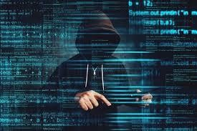
Cont…
Here are some common methods used to
threaten cyber-security:
Phishing
Ransomware
Malware
Social engineering
SQL injection
Man-in-the-middle attack
Denial-of-service attack

Slide 14
Cont…
Phishing's the practice of sending fraudulent emails that resemble emails from reputable sources.
The aim is to steal sensitive data like credit card numbers and login information.
It’s the most common type of cyber attack. You can help protect yourself through filters malicious emails

Slide 15
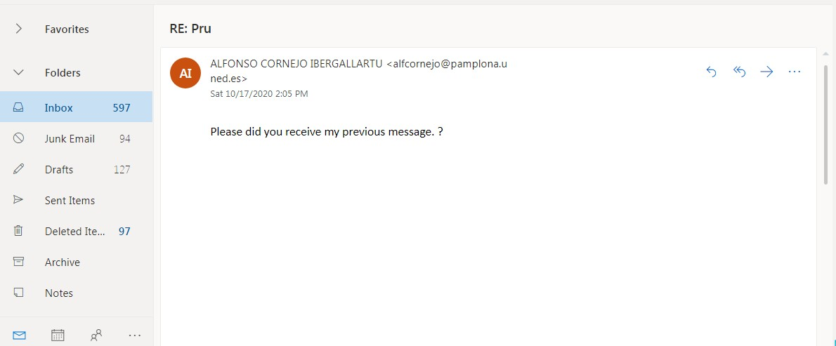
Cont…

Slide 16
Cont…
Ransomware is a type of malicious software
It is designed to extort money by blocking access to files or the computer system until the ransom is paid.
Paying the ransom does not guarantee that the files will be recovered or the system restored.

Slide 17

Cont…
Malware is a type of software designed to gain unauthorized access or to cause damage to a computer.

Slide 18
Cont…
Social engineering is a tactic that adversaries use to trick you into revealing sensitive information.
They can solicit a monetary payment or gain access to your confidential data.
Social engineering can be combined with any of the threats listed above to make you more likely to click on links, download malware, or trust a malicious source.

Slide 19

Cyber safety tips - protect yourself against cyber-attacks
Update your software and operating system: This means you benefit from the latest security patches.
Use anti-virus software
Use strong passwords: Ensure your passwords are not easily guessable.
Do not open email attachments from unknown senders: These could be infected with malware.

Slide 20

Cont…
Do not
click
on links
in emails
from
unknown
senders or unfamiliar websites:
This is a common way that malware is spread.
Avoid using unsecure WiFi networks in public places: Unsecure networks leave you vulnerable to man-in-the-middle attacks.

Slide 21
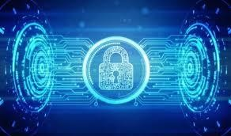
Online Banking
From 24-hour access to your account, anytime fund transfers and bill payments, it's no surprise that over 50% of Indians prefer online banking to traditional banking.
But, if you’re not careful, banking from the comfort of your life opens you up to several security risks that can be avoided if you are very, very careful.

Slide 22
Online Banking Frauds
A recent survey by Telenor is to be believed Indians are losing more money to online fraudsters than their Asian counterparts.
As per the statistics, 36% Indians were cheated online, which is about Rs 8.19 lakh average financial loss per person from Internet scams, compared with Rs 6.81 lakh per person in Asia.
The survey further reveals 17% of the respondents have victim to fake bank e-mail fraud.

Slide 23

Cont…
Trojan: Trojan is an internet virus that gets
installed internet websites.
Phishing
in your or
while browsing downloading from unsecured
computer
•
Emails: As
the name
suggests,
these are
fraudulent emails, claiming to
come from the authorised channel.
Money scam:
mule / Additional income email Money Mules are unaware victims,
invariably job-seekers and those seeking to make easy-money online.

Slide 24
Keep these tips in mind while banking online
Avoid
using internet banking on shared
computers and public places like cafés and libraries.
Always remember to log-off on internet banking and close your browser when you have finished your online banking.
Disable the 'AutoComplete' function within your browser.
Install firewall and anti-virus software and keep it up to date to help detect and disable malicious software.

Slide 25
Reference
https://us.norton.com/internetsecurity-malware-what-is-cybersecurity-what-you- need-to-know.html
https://www.kaspersky.co.in/resource-center/definitions/what-is-cyber-security
https://www.cisco.com/c/en/us/products/security/what-is-cybersecurity.html
https://www.axisbank.com/bank-smart/safe-banking/precautions-for-online- banking#menuTab
https://economictimes.indiatimes.com/wealth/spend/8-tips-to-use-internet-banking-
safely/articleshow/55113849.cms
https://nakedsecurity.sophos.com/2013/10/03/8-tips-for-safer-online-banking/
https://www.bajajfinserv.in/what-is-atm-fraud-and-types-of-atm-fraud
https://www.business-standard.com/article/finance/maharashtra-tops-in-atm-frauds- delhi-tamil-nadu-karnataka-follow- 119072200187_1.html#:~:text=Maharashtra%20reported%20233%20cases%20of,14 7%20cases%20of%20ATM%20fraud.
https://support.google.com/accounts/answer/2812853?hl=en
https://www.google.com/search?source=univ&tbm=isch&q=cyber+security+images &sa=X&ved=2ahUKEwjlm5Xm0MPsAhVEwjgGHZWjBkUQjJkEegQIARAB
https://niccs.cisa.gov/about-niccs/cybersecurity-glossary

